Slide 1
A Simplified Approach to Complex 5-Axis Milling
DP Technology Corp.
Notes:
Most people associate 5-axis machining with complicated motion and complicated programming techniques.
In reality, 5-axis machines are versatile, accurate, and are available in a variety of configurations and prices.
And most CAD/CAM systems today include at least basic functionality for multi-axis machining.
Because 5-axis technology is more affordable than ever, 5-axis is becoming the norm instead of the exception.
The purpose of my presentation is to demystify the process of programming a 5-axis machine.

Slide 2
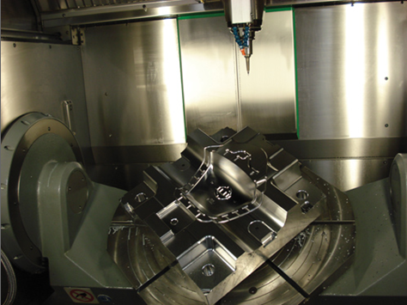
Benefits of 5-Axis Machining
Single setup
Better accuracy
Expanded range of part types
More creativity in the cut
Notes:
5-axis machines have the benefit of two additional axes of rotation in addition to the standard linear axes of X, Y, and Z. The rotary axes can either tilt the tool during the cut or tilt the part.
The appeal of multi-axis machine tools is obvious.
First, these machines typically require only one setup since the part or the tool can be rotated to cut in virtually any direction. A single setup not only saves time, it also improves accuracy between operations.
5-axis machines also support complex shapes that cannot be machined with standard methods or cannot be machined efficiently. Adding a 5-axis machine greatly expands the range of parts a shop can cut.
The biggest benefit is that multi-axis machines have become more affordable in recent years, even for the smaller job shops.

Slide 3
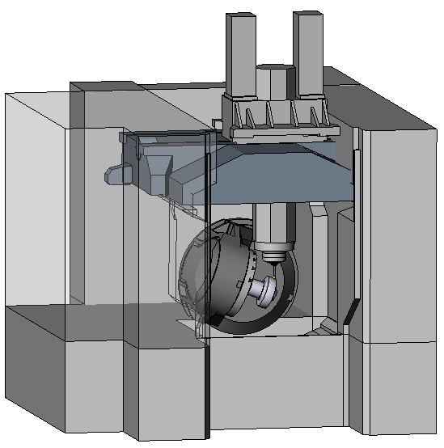
Challenges of 5-Axis Machining
The CAM system must support the kinematics of any 5-axis machine
Proper definition of machine motion is critical to a good calculation of the toolpath
Notes:
The challenge for a CAM system is to generate CNC programs that fully exploit additional axes of motion in an efficient manner.
Every machine tool is different, each having its own set of components that either move or remain stationary. It’s essential that a CAM system be able to support any type of machine kinematics. This is important for generating the best toolpath for the type of machine and it’s even more important for detecting collisions that can cause a machine to crash.
The smallest programming error can generate costly damages to the part or to the machine itself.

Slide 4
Traditional CAM Approach
Create a dozen or more functions for very specific machining strategies, especially finishing routines
Keep adding functionality as the technology changes
Never remove old functionality
Expect the CNC programmer to learn and remember all those functions
Notes:
The initial development of multi-axis CAM functionality was driven by the need to solve specific application challenges for large aerospace companies. Because of this legacy, CAM software developers have almost always fragmented their 5-axis functionality into various dedicated functions for very specific types of tool path. In fact, a point of pride for some CAM developers is the large number of functions they have available.
The price to be paid for this type of software development is that soon the system becomes a labyrinth of functions with the typical end user knowing and exploiting only a limited number of them.
In reality, the majority of companies aren’t building jet engines or race cars.
In reality, the majority of companies want to save time and simplify their programming processes by machining their parts in one setup on a multi-axis machine instead of moving parts manually from machine to machine.

Slide 5
Traditional Problems
Fragmented functionality
Too many choices to remember
Only a few functions get used
Prone to inconsistencies
Difficult to update
Notes:
Busy CNC programmers cannot possibly be expected to memorize the purpose of dozens of functions in a CAM system. Programmers typically stick to the functions they know best and ignore the rest.
The traditional approach to software development also becomes a nightmare for the CAM company to maintain when a dozen or more functions need to be updated just to add a new parameter for new technology.
The more maintenance involved in a software product, the more chance for error. And the greater chance that the CNC programmer will not know about the change.

Slide 6
A Simplified CAM Approach
Use a single function
Follow the logic of machinists
Keep the function easy-to-use
Impose few limitations
Use a modular approach for efficient updates
Notes:
A much better idea is to create a single milling function that meets the needs of machinists today and in the future. Furthermore, any software product designed for multi-axis machines must be kept easy-to-use and error-proof.
Common sense tells us to follow the same logic that machinists themselves use when deciding how to program a part. That way, the process is familiar and easy to remember.
The challenge for CAM software developers is how to combine a set of powerful programming functions with a process that is easily understood by the user.
That challenge is solved by a CAM function called a “Composite”. The principle behind a Composite function is to simplify the programming of multi-axis machines.
The concept of a Composite function is to use a modular approach for software development, somewhat like building blocks.

Slide 7
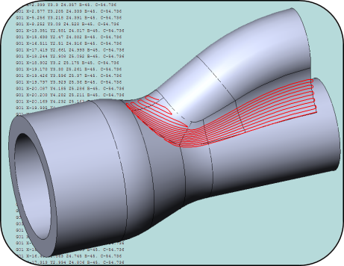
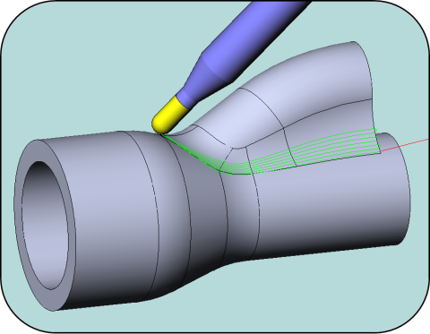
Composite 5-Axis Function
Modular development
The machining pattern and tool orientation are defined separately
Modules are fully tested to work separately and together
New patterns and orientations can be easily added or removed in the future
+
Notes:
A Composite 5-axis function is developed as interlocking modules that perform well separately and together. The idea is to take a complex process and simplify it into easily definable modular steps.
The goal of modular software development is to improve reliability and eliminate redundancy with a framework that can support rapidly evolving technology.
The modular design of the software allows for easy expansion to other machining patterns and other tool orientation strategies in the future.
If a new machining pattern needs to be added, only the pattern module is updated.
This type of software development is not only faster to implement, it results in a much more reliable software.

Slide 8
Advantages of a Composite Function
One function = Programming Your Way
6 machining patterns
+ 5 tool orientation strategies
= 30 unique 5-axis machining strategies
Or, lock 1 axis to convert to 4+1 machining
Or, lock 2 axes for 3+2 machining
Notes:
With a single Composite function, a machinist can use those building blocks to create customized tool path as a combination of available choices.
By choosing any one of several available machining patterns and any one of the available tool orientation strategies, the user has multiple ways to machine a part.
Add to that the ability to lock an axis and 5-axis toolpath is quickly converted to a 4+1 application.
Or, the tool can be rotated into position using the 2 rotary axes and then locked to create a 3+2 program. This is an important application for a 3-axis milling machine equipped with a rotary table.
That way, the user can do more with a 5-axis function than just 5-axis simultaneous machining.

Slide 9
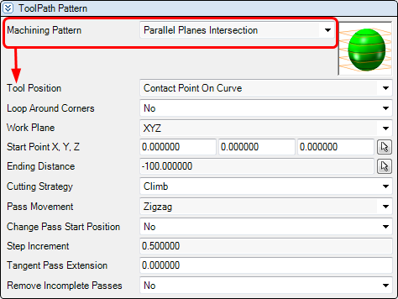
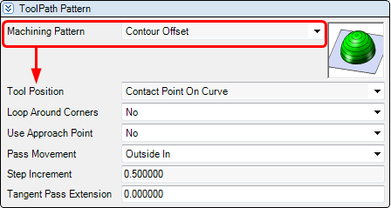
Advantages of an interactive interface
The interface responds to the user’s choices
Show the options that are needed
Hide the options that aren’t
Guide the user without imposing restrictions
Notes:
To simplify matters even further, the interface should only display options that apply to the current work situation.
For example, if the user chooses a planar machining pattern, the system should only display the settings that pertain to planar cutting such the distance and direction of the cutting passes. If the user decides to change to a simple boundary offset pattern, the interface should update to display fewer options.
In effect, the interface is responding intelligently to the choices being made. As options are chosen, the interface updates immediately to guide the user in a logical manner through the programming process.
This step-by-step guidance helps the user avoid errors in the toolpath definition without imposing limitations. If the user decides to change a previous option, the system responds by displaying a new set of choices.

Slide 10
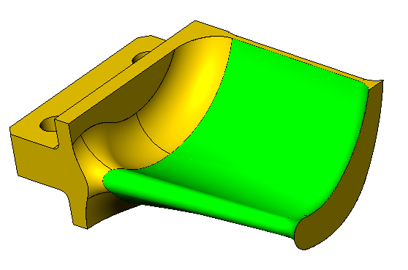
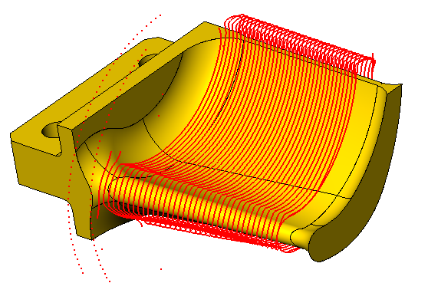
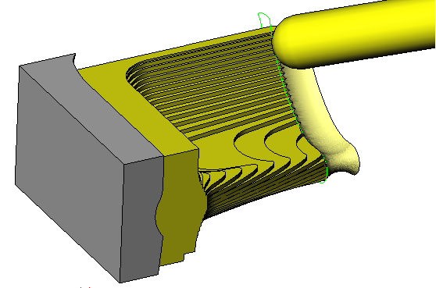
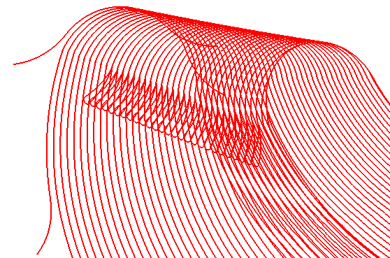
4 Simple Steps
1. Define the area to machine
2. Define the shape of the tool path
3. Define the tool orientation
4. Define the transitions between cuts
Notes:
To keep things simple, the Composite function follows 4 simple steps.
These steps are based on the standard workflow for any type of machining, whether it’s 2-axis or 5-axis, lathe or mill. It just makes sense to align the technology with the same logic that machinists already use.
The first step is to obviously define the area that needs to be machined.
The next step is to define the shape of the toolpath on that area.
After the shape is defined, the user decides how the tool will travel along that toolpath.
Finally, the user decides how the tool should transition between cutting passes.
These steps may be defined separately but they are designed to work together smoothly.

Slide 11
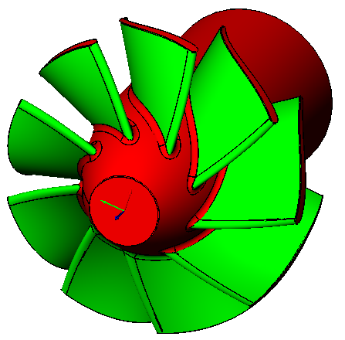
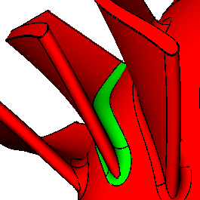
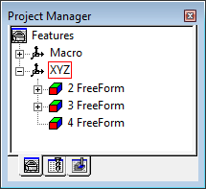
Step 1: Define the area to machine
Select and save areas to machine as a single feature
Create multiple features on a single model
Notes:
The first step is to define which areas will be machined. Depending on the CAD model, this step could involve dozens of surfaces.
To make this step easier, a new type of machinable feature has been developed. It’s called a FreeForm feature. A FreeForm feature lets the user select and save the surfaces to be machined and the surfaces to be avoided as a single object.
Areas to machine are displayed in green and areas to avoid are displayed in red.
Knowing that different types of surfaces require different machining strategies, any number of freeform features can be created on a single part model.

Slide 12
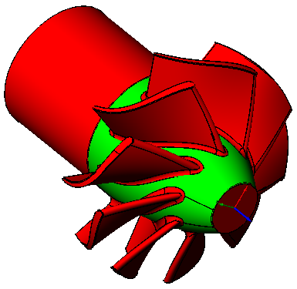
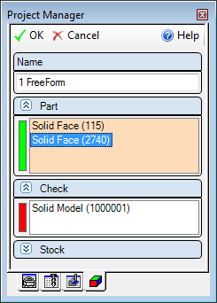
FreeForm Features
Select the surfaces to machine (green)
Select the surfaces to avoid (red)
Notes:
It’s very easy to create a FreeForm feature.
The user first selects the solid faces or the surfaces they want to machine. Each face or surface is added to a list where it can be highlighted on the screen or deleted if it was selected by mistake.
The same process is used to select the check surfaces that need to be avoided.
To make the selection of check surfaces faster, an entire solid model can be selected. The system is smart enough to automatically exclude any surfaces already selected for machining.

Slide 13
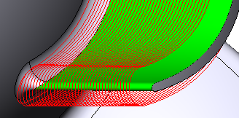
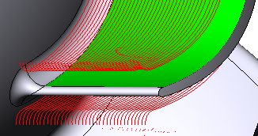
Advantages of feature-based machining
Add or remove surfaces/faces from a feature at any time
Toolpath is associated with the feature
Editing a feature automatically updates the toolpath
Notes:
After features are created, they can be reopened at any time in case the user needs to add or remove surfaces.
What’s nice is that any machining operations that have been placed on a feature are automatically updated when the feature is edited.
In this example, a surface is removed from the feature and the system updates the toolpath.

Slide 14
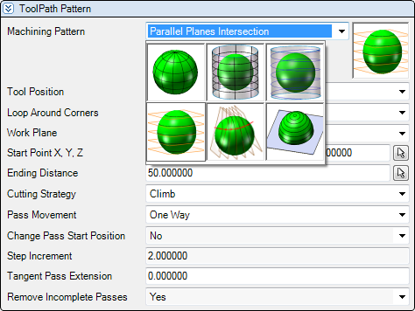
Step 2: Define the shape of the tool path
Choose from a variety of options:
Parametric
Projected parametric
Spiral
Planar along a vector
Planar along a curve
Offset
Notes:
Now that the user has defined an area to machine, the next challenge is to decide what the toolpath will look like on that area.
The Composite function currently supports 6 types of machining patterns that are common to multi-axis machining.
Let’s discuss each pattern and its typical application.

Slide 15
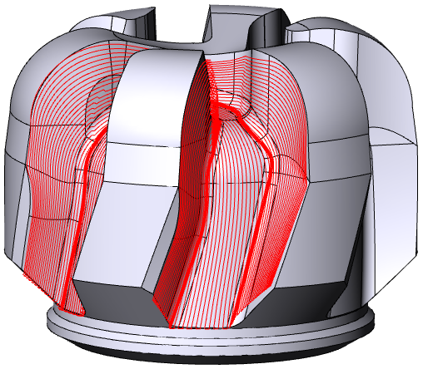
Parametric
The toolpath follows the flow lines of the surfaces
2 types of parametric tool path:
Use a surface on the model
Project the flow lines from a separate surface
Notes:
The most common type of toolpath for flowing surfaces is a parametric toolpath.
Parametric machining follows the natural flow lines of the model itself. For blended surfaces this is usually the best option.
However, the quality of the machined surface depends largely on the quality of the original CAD model. As long as the flow lines in the CAD model are smooth and continuous, the toolpath will be too.
But, since CAD models aren’t always perfect, there are ways to overcome flaws in the model so the toolpath will still produce the desired smooth finish.

Slide 16
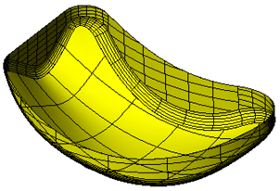
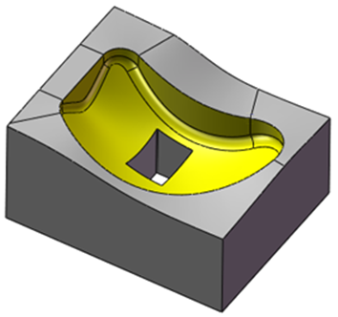
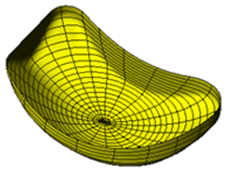
A note about projection surfaces
A projection surface can overcome problems with misaligned faces in the CAD model
The Knitted Surface tool creates a single surface from multiple faces on a solid
Flow lines are smooth and continuous
Notes:
When a part model consists of multiple and varied surfaces, it’s likely that those faces won’t be aligned in a way that makes for ideal machining conditions.
The Knitted Surface tool in ESPRIT overcomes the problem of misaligned faces. A Knitted Surface creates a single continuous surface from any number of connected faces on a solid model.
This knitted surface can then be used to drive a parametric machining pattern on the underlying model.
That way, smooth and continuous toolpath can be generated without changing the original part model.

Slide 17
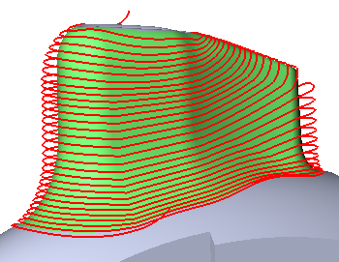
Spiral
Spiral tool path projects a continuous spiral pattern onto the machining area
This pattern requires a closed shape
Notes:
A machining pattern that’s almost identical to parametric machining is spiral machining.
The only difference is that it’s always used on a closed shape like this example.
A big benefit of spiraling passes is that the cutter stays in contact with the part at all times.
Spiraling also works well with high-speed machining because there are no sharp transitions in the toolpath.

Slide 18
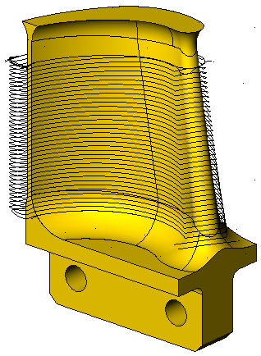
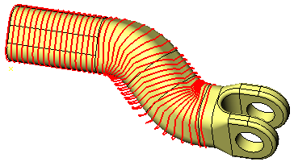
Planar
Planar tool path creates a uniformly spaced stepover based on a set of calculated planes that slice through the part
2 types of planar tool path:
Along a linear path
Along a curved path
Notes:
One of the oldest and most classic machining patterns is the Planar option.
Planar toolpath has relatively uniform spacing between cutting passes and is used when you want to start cutting at one end of a part model and stop cutting at a specified distance.
The Composite function supports classic planar cutting that uses a vector to define the direction and distance for the evenly-spaced cutting passes.
Another option is to select a drive curve instead of a straight vector. In that case, the distance between cutting passes is calculated by spacing the slice planes for the planar cuts at equal distances along the curve.

Slide 19
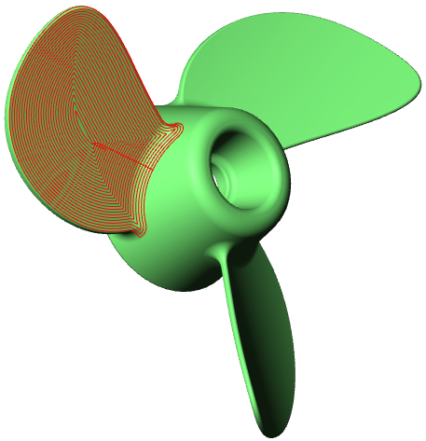
Offset
The boundary of the area is offset to create a concentric pattern
Machine from the outside in or from the inside out
Notes:
Another classic machining pattern is a concentric pattern.
This pattern works well on areas with a defined outer boundary.
The shape of the outer boundary is calculated and then progressively offset towards the center.
As with any other concentric toolpath, the tool can start in the center and move progressively outward or start on the outer boundary and move progressively inward.

Slide 20
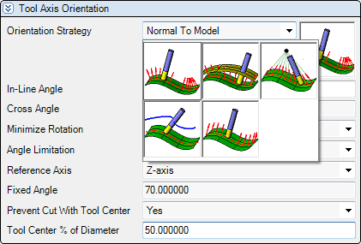
Step 3: Define the tool axis orientation
Choose from a variety of options:
Normal to the model
Perpendicular to a projected surface
Through a point
From a fixed vector
From a profile
Notes:
After the machining pattern is defined, the fun of 5-axis begins with the decision on how to orient the tool axis.
Some of your choices will depend on the capability of the machine and some on what you want to achieve with the surface finish.
The Composite function has 5 strategies for the tool orientation.
Each strategy also has additional ways to put more control on the tilt of the tool.

Slide 21
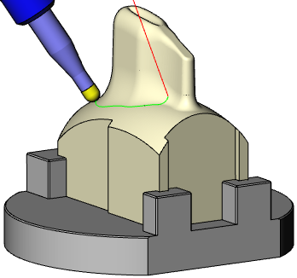
Keep the tool normal to the model
The tool axis is always perpendicular to the model surfaces
Notes:
A classic strategy for simultaneous 5-axis machining is to keep the tool axis perpendicular to the surfaces being cut at all times.
This strategy works extremely well when the flow lines on the CAD model are smooth and continuous.

Slide 22
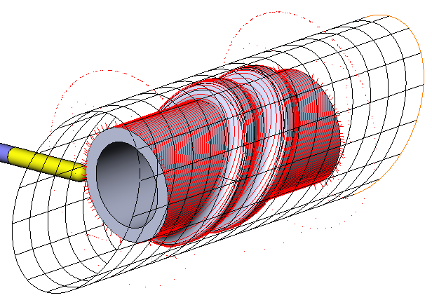
Perpendicular to a projected surface
Keep the tool axis perpendicular to a drive surface
Notes:
As previously discussed, the flow lines on the CAD model may be less than ideal for machining.
Using a separate surface to drive the tool gives you better control over the orientation of the tool.
Depending on the complexity of the model being cut, keeping the tool normal to a separate drive surface can smooth the motion of the tool.

Slide 23
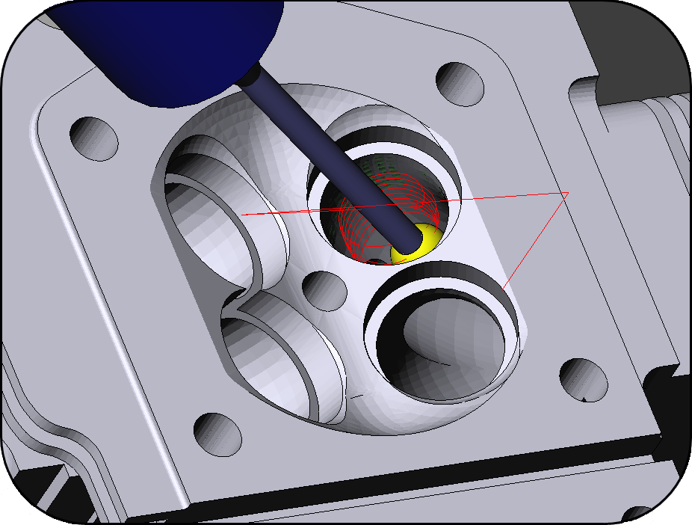
Through a point
The tool axis is forced to pass through a specified fixed point
This strategy works well on internal surfaces with a restricted opening
For convex surfaces, the tool can go Toward a point
Notes:
For any application where the tool needs to pass through a restricted opening, a fixed point is always used to control the rotation of the tool.
This prevents the shank of the tool from ever coming into contact with the edges of the opening. The placement of the point depends on the length of the tool and the depth of the cutting passes inside the opening.
This strategy also allows the placement of the point to be inside a part model. In that case, the tool will be oriented towards the point instead of through it.

Slide 24
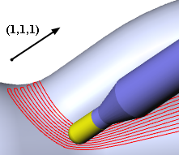
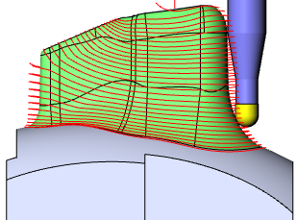
Fixed tool orientation
This strategy creates 3+2 toolpath
The fourth and fifth axes are used to orient the cutting tool in a fixed position
Allows for the use of a shorter, more rigid cutting tool
Notes:
A fixed tool strategy locks the tool into a tilted position using the rotary axes to initially position the tool.
This is called 3+2 machining because the fourth and fifth axes are used to orient the cutting tool in a fixed position rather than manipulate the tool continuously during the machining process.
The main benefit of 3+2 machining is that it allows for the use of shorter, more rigid cutting tools. The spindle head can be lowered closer to the workpiece with the tool angled toward the surface.
This technique is popular with mold shops because it helps with deep cavities in complex molds.

Slide 25
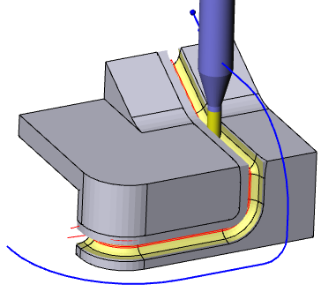
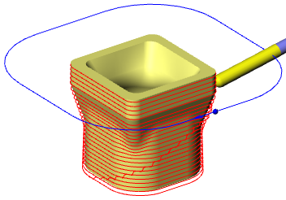
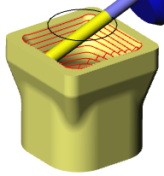
From a profile
The tool axis is forced to pass through the points of a 3D curve
This strategy works extremely well for machining in a channel or areas where the tool could collide with a wall
The tool can also go Toward a profile instead of through it
Notes:
Another way to control the tool is to force it to pass through a curve.
This technique is similar to the fixed point method except that it is used for situations where the tool must machine between steep walls instead of a small opening.
As with the fixed point method, you can also orient the tool toward a profile instead of through it.

Slide 26
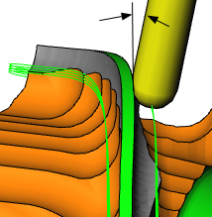
Additional tool control
Control the forward and sideways tilt of the tool
Add a cross angle to tilt the tool sideways to avoid collisions
Add an in-line angle to tilt the tool forward for a “pulling” cut
Tilting the tool helps move the contact point away from the bottom of the tool
Notes:
In addition to the pre-defined tool orientation strategies, the machinist also needs control over the sideways or forward tilt of the tool as it travels along the toolpath.
The ability to tilt the tool away from normal lets the machinist control the contact point between the tool and the surface being cut. This may be desirable to tilt the tool away from a vertical wall or to avoid cutting with the bottom of the tool on a floor.
In the case of the Composite function, a Cross angle is used to control the sideways tilt of the tool. The tool can be tilted to the right or the left in the direction of the cut.
What’s called an In-Line angle controls the forward or backward tilt of the tool in the direction of the cut.
These angles can be used to modify any of the 5 orientation strategies.

Slide 27
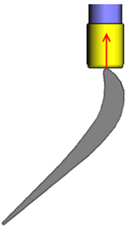
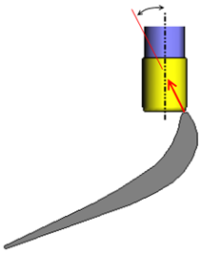
Control the tool contact point
Bull nose end mills are preferred but controlling the contact point can be tricky
Automatically shift the tool to prevent cutting with the center
Tilt the tool to move the contact point away from the center
Increase tool life
Notes:
Bull nose end mills are a primary reason why a machinist wants to control the contact point of the tool. Bull nose end mills are usually preferred for multi-axis machining because they can take wider cutting passes than ball nose end mills and cut with a more constant cutting speed.
However, it is not ideal to cut with the bottom of a bull nose end mill.
Cross angles and inline angles can be used to tilt the tool and change the contact point. This is especially useful when machining a turbine blade as shown in this example.
The Composite function also has a control that prevents cutting with the center of the tool. When the control is enabled, the tool is automatically shifted away from center by a percentage of the tool diameter.

Slide 28
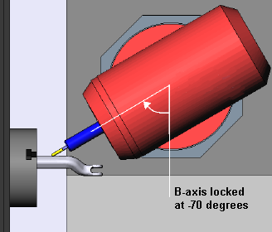
Place limits on the tool axis
Define axis limits
The tool axis orientation will never exceed the minimum and maximum angle with respect to the specified axis (X, Y or Z)
Machine at a fixed angle
The tool axis keeps a fixed slope for 4+1 machining
Notes:
When a mill-turn machine has a B-axis, placing limits on the motion of the B-axis is very important.
Each mill-turn has specific limits on how much the B-axis can rotate. These limits need to be specified in the program so the correct toolpath can be output.
Another advantage of limiting an axis is to produce 4+1 toolpath.
In 4+1 machining the B-axis is rotated and then locked into position while the turning axis is still free to rotate.
This allows the production of camshafts, turbine blades and other types of shaft work that requires rotation of the part.

Slide 29
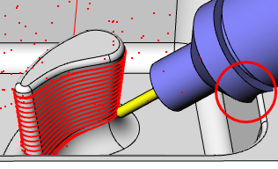
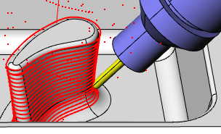
Avoid collisions with Auto Tilt
Use the preferred tool axis orientation until a collision is detected
Automatically switch to rule-based alternative tool orientations to adjust the tool axis
Auto Tilt = Off
Auto Tilt = On
Notes:
An automatic tilt option is also important to 5-axis machining. Let’s say you’ve defined your tool axis orientation, but the system detects a collision before the entire area is machined. At that point, the system will end the toolpath because the tool cannot reach the rest of the area in its current position.
However, an Auto Tilt function lets you define rules about what the system should do in case a collision is detected.
That way, if the system does detect a collision, Auto Tilt will try alternative orientations based on the maximum change in tilt allowed and the allowed direction of the tilt.
An automatic tilt function allows the rest of the area to be machined without having to create a second toolpath or having to start over with a different tool orientation for the entire toolpath.

Slide 30
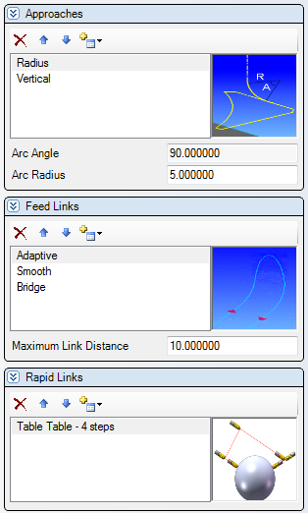
Step 4: Define linking strategies
Create prioritized lists of preferences for:
How the tool feeds to and away from the part
How the tool feeds between adjacent cuts in the toolpath
How the tool rapids between cutting passes or to another position
Notes:
The final step in this process is to define the links. Links are the moves the tool makes as it approaches the start of the toolpath and how the tool moves when it needs to transition within the toolpath.
For the smoothest surface possible, the manner in which the tool moves from the end of one cutting pass to the start of the next requires finesse and control.
Multiple choices in a prioritized list takes the guesswork out of which linking methods are preferred by the machinist.
Separate strategies can be created for how the tool approaches the part, how the tool should feed between passes and how the tool should rapid from one position to another.

Slide 31
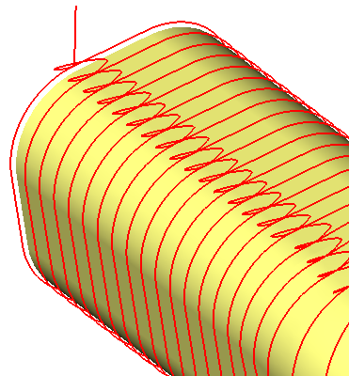
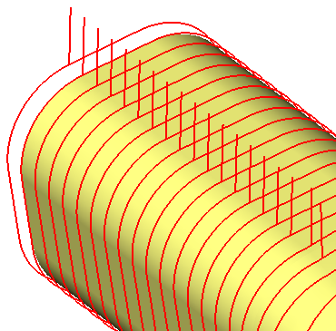
Feed link or rapid link?
The user only needs to define the maximum gap distance for feed movements
Any gap larger than the maximum distance generates a rapid move
Notes:
The usage of feed links versus rapid links is controlled by only one setting, the Maximum Link Distance.
The user only needs to define a maximum distance for feed moves and the system takes care of the rest.
As soon as the system detects a gap between cutting passes that is larger than the user-defined distance, it will generate a rapid move.

Slide 32
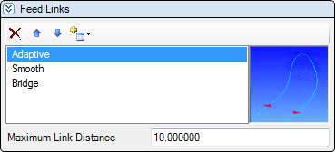
Advantages of prioritized lists
Links are applied in the order the user defines
If the first link in the list is not possible, the system uses the next linking technique and so on
Notes:
Most CAM systems offer several options for linking moves but the user typically has to choose just one of those. With 5-axis machining there are just too many variables with the machine motion to limit the choices for tool transitioning moves.
The logical answer is to let the programmer choose a favorite, a next favorite, and so on.
For example, top priority can be given to a linking method that keeps the tool on the surface the entire time, but if that method is not possible then the system can look at the user’s list of preferences to see how to behave next. As a second priority, the user prefers a link that lifts the tool off the surface with a radius move and then returns to the surface at the next cut with a tangent radiused move.
That way, the user can prioritize linking methods and there is less chance that the machining operation will fail or cause gouging because of an inappropriate move when the tool repositions.

Slide 33
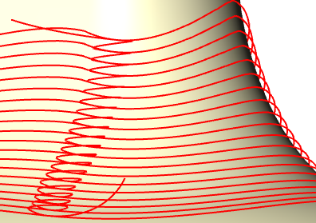
Fluid links
All links provide smooth transitions
All links are calculated for the best results for the machine
Notes:
Finally, surface finish is extremely important in multi-axis machining operations.
Transition moves must be smooth to avoid leaving witness lines and tool marks.
Be sure to look for a 5-axis software that guarantees to move the tool fluidly between cutting passes.

Slide 34
Unlimited Creativity
Create your own customized tool path
Try different techniques without using multiple functions
Try different tool orientations before deciding on the perfect cut
Notes:
Any software product designed for multi-axis machines must be kept easy-to-use and error-proof.
Highly-advanced CAM software technology can eliminate the conflict between powerful 5-axis functionality and ease-of-use.
A Composite function gives machinists the flexibility to try out different machining techniques without ever having to re-enter data about the part.
A CAM system should help a company enter the multi-axis arena and help them tackle the kinds of complex work that brings in more business and more profits.
Thank you.

