Slide 1
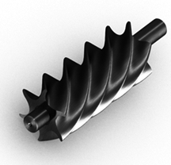
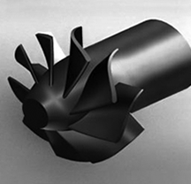
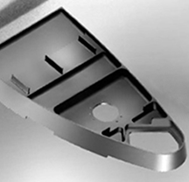
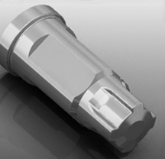
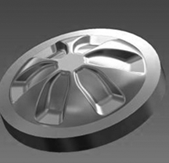
POWERFUL
FULL-SPECTRUM
CAM SOFTWARE
BACKED BY
FACTORY-DIRECT
SUPPORT
we are ESPRIT

Slide 2
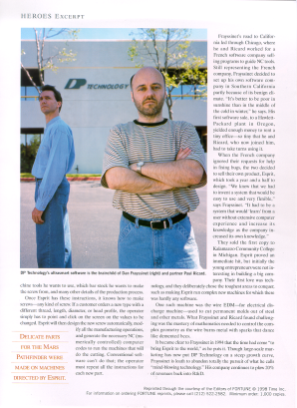
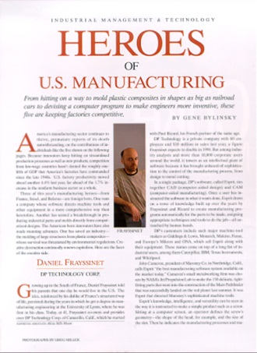
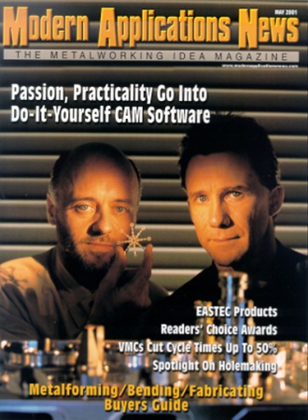
DP Technology Corp. Founders
Dan Frayssinet
CEO
+
Paul Ricard
President
=
Over 50 years of combined manufacturing experience

Slide 3
DP Technology Corp. World-Wide
USA
Los Angeles
Chicago
Charlotte
EUROPE
Montpellier, France
Nürnberg & Berlin,
Germany
Florence & Milan, Italy
ASIA
Tokyo, Japan
Shanghai, China
Chennai, India
121 Employees on 3 Continents
200 resellers serving more than 80 Countries

Slide 4
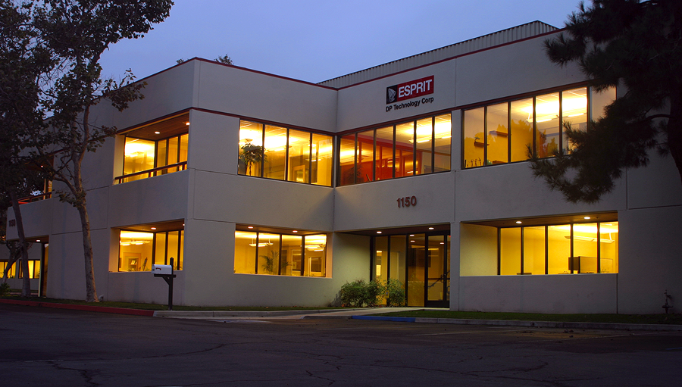
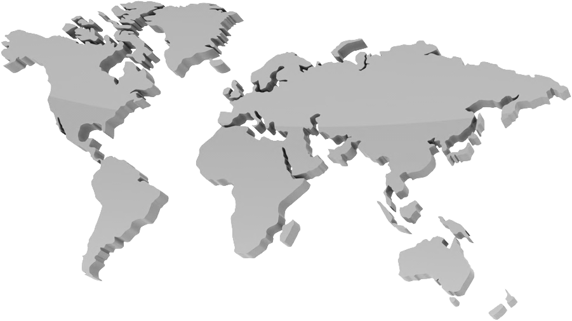
Corporate Headquarters Camarillo, California
Main ESPRIT R&D Center
An International group of developers
Strength in Diversity
Experience – Education - Skills - Culture

Slide 5
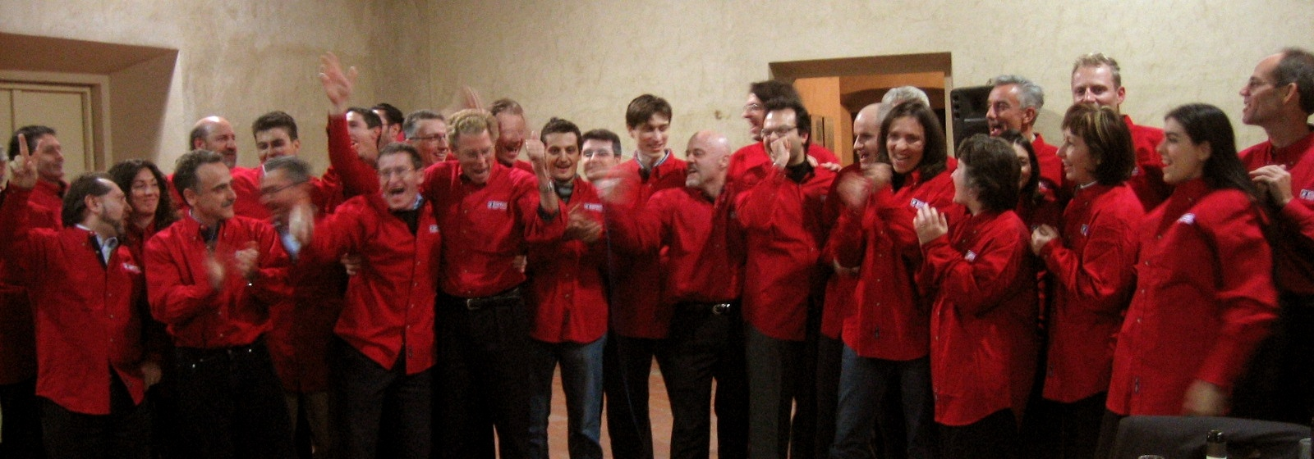
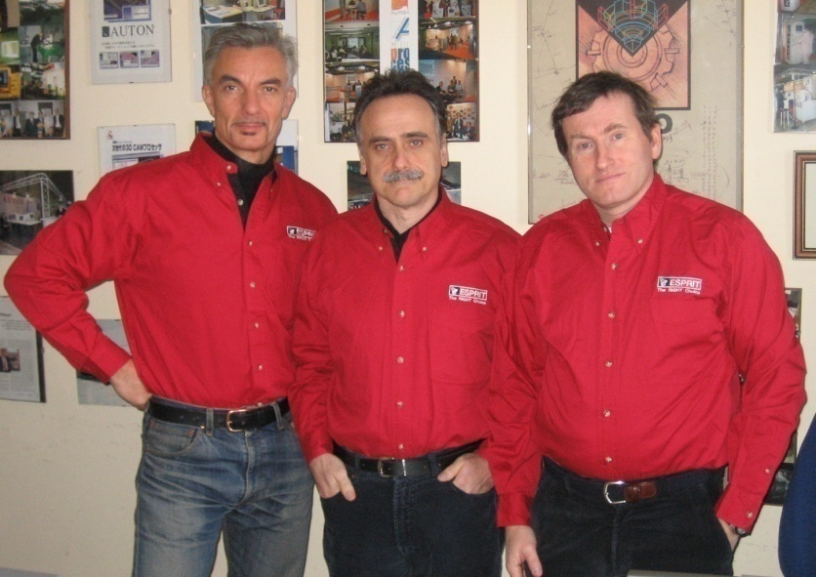
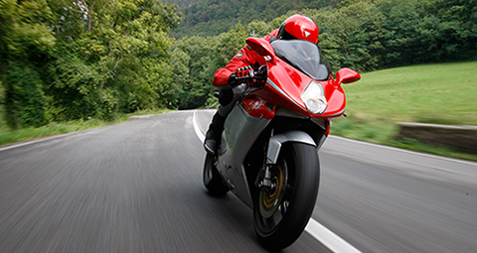
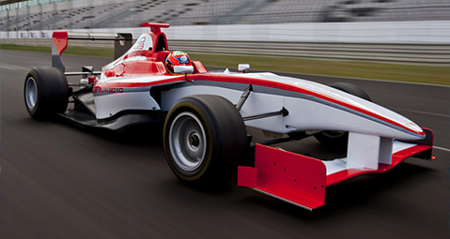
Florance, Italy Auton
R&D Center for FreeForm Machining
3-axis Machining
5-axis Machining
A division of DP Technology Corp.
Auton srl.
25+ Years of Experience
Extensive world-wide customer base

Slide 6
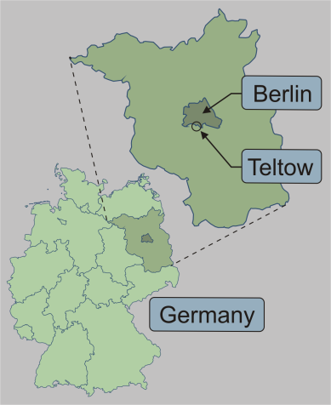
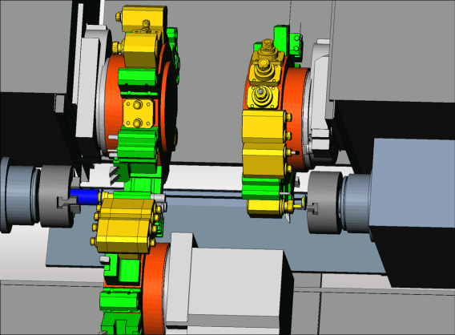
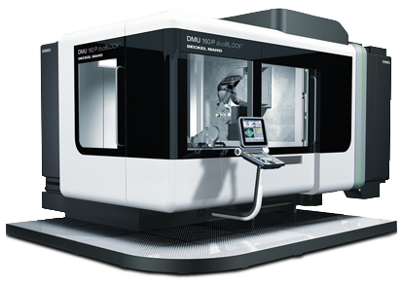
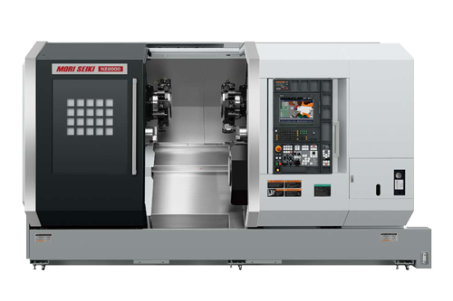
Berlin, Germany BinarySpaces
R&D Center for Virtual Machining Technology
Machine Simulation
Tool Path Verification
A division of DP Technology Corp.
BinarySpaces GmbH.
10+ Years of Experience
Customers include: major European and Japanese machine tool builders

Slide 7
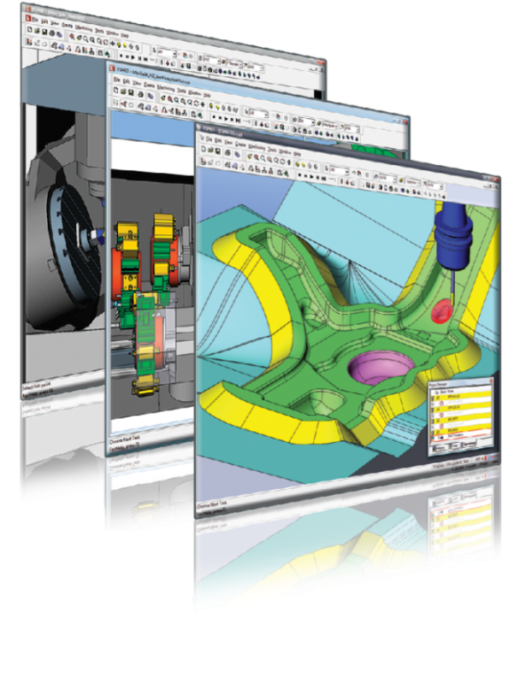
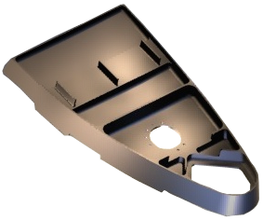
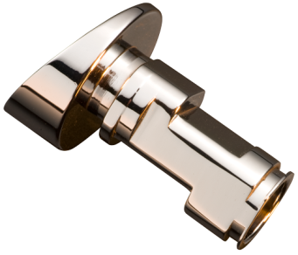
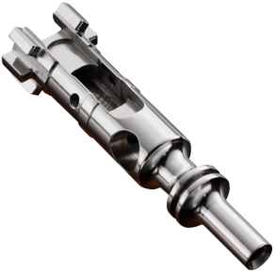
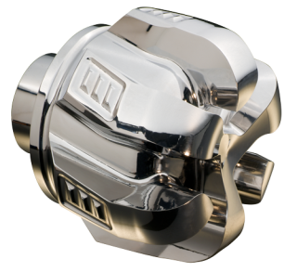
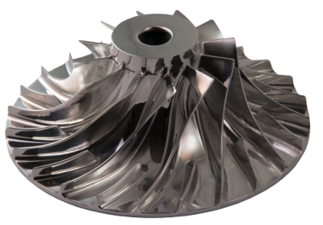
ESPRIT CAM Software
The ESPRIT CAM system delivers powerful, high-performance, full-spectrum CNC programming for:
2–5 axis milling
2–22 axis turning
2–5 axis wire EDM
High-speed 3- and 5-axis machining
Swiss-turn, mill-turn and B-axis machine tools

Slide 8
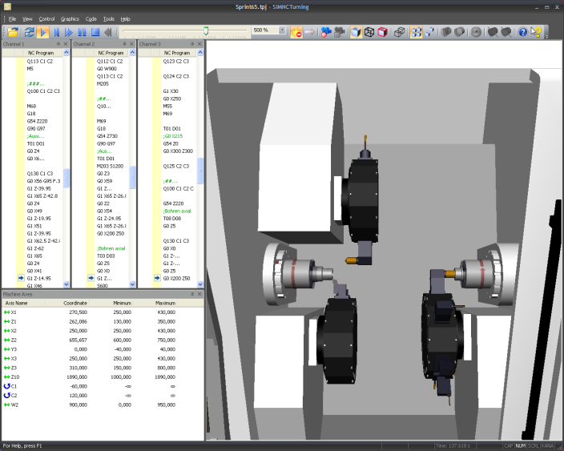
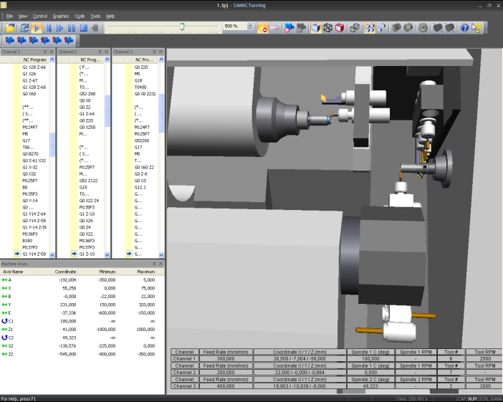
SIMNC Virtual Machining
Innovative software for the 3D simulation of multi-axis CNC machines and machining processes
Machine Tool Simulation
Part Program Verification
Dynamic Material Removal
Comprehensive Collision Detection

Slide 9
Software Shipments
In excess of $38 million USD

Slide 10
Licenses
Over 57,000 Licenses Shipped

Slide 11
MARKETS
Aerospace
Automotive Transportation, Railroad, Subway
Construction Infrastructure & Off-Road Equipment
Defense & Military
Education & Research
Electronics Computers & Telecommunications
Energy Oil & Gas, Power Generation, Alternative Energy
Hydraulics Pumps, Valves, Mechanical Components & Motors
Job Shop Tool & die, Mold & die, Machine Shops
Machinery Manufacturing Machine Tools, Packaging, Printing
Medical Equipment, Instruments & Implants

Slide 12
customers

Slide 13
customers

Slide 14
customers

Slide 15
partners

Slide 16
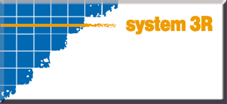
partners

Slide 17
research

Slide 18
research

Slide 19
We Are ESPRIT
The most powerful CAM software ever.
we love what we do …
and our success shows in you
© 2011 DP Technology

