Slide 1
Intro

Slide 2
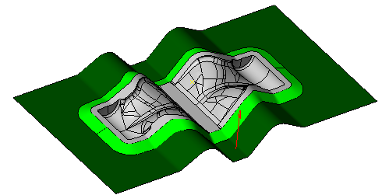
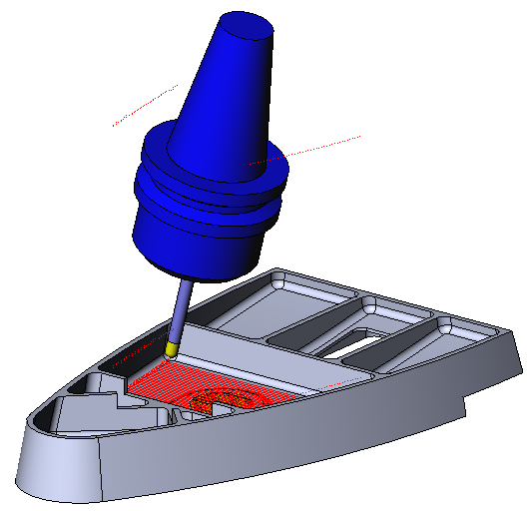
Presenters:
FreeForm
3-Axis & 5-Axis
Essentials

Slide 3
You will learn…
Improvement on geometry to support 3 and 5-axis cycles
Analysis command to inspect model and tool path
Simulation enhancements
Enhancements on Mold 3-axis cycles
Enhancements on Mold 5-axis cycles

Slide 4
Geometry
Stitching of IGS
FreeForm feature and sheet body
Solid
  Split face
Curves
  Curves from Surface
  Projected Curve

Slide 5
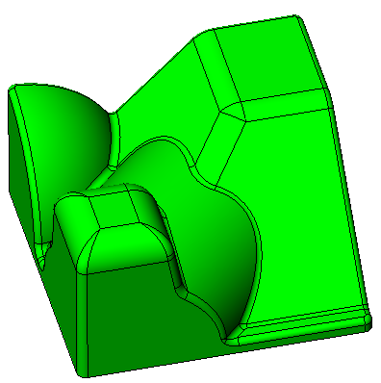
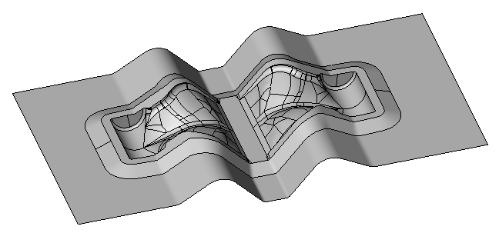


IGES Stitching
Create sheet solid body or closed solid body
Advantages of cutting solids:
  Connected faces
  Single orientation for the whole body
  Knitted surface
  Selection with propagation
Notes:
1: Open IGS import options. Turn off stitching. Open file ClosedBody.igs.
Turn on stitching, open file Closed body again.
2: Open Sheet.igs with stitching on. It creates a sheet body.

Slide 6
Sheet Body Orientation
Single orientation for the whole sheet body
  All faces of same body have same orientation
Closed body: No orientation to set, automatically set by material side.
Notes:
Create FFF with sheet body in part. Show orientation reversal.
Create FFF with faces of the sheet body in part. Show orientation reversal.
Create FFF with closed solid in hidden layer. Orientation cannot be reversed.
Create FFF with surface in hidden layer. Orientation can be reversed per surface.

Slide 7

Split Face
In Solid Modeler toolbar
Applications:
  Limit machining zone
  Knitted surface
  Overlap between 2 machining
  Extract geometry from new edges
4 methods:
  Shortest Path
  Plane Intersection
  Draft Line
  Parametric Curve

Slide 8
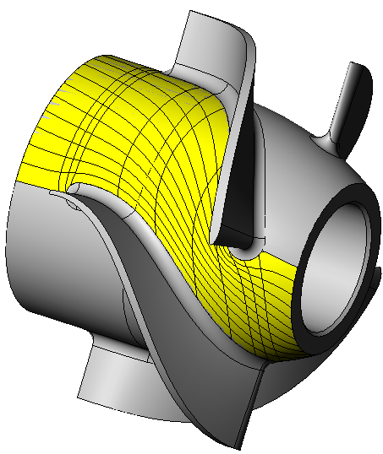
Split Face: Shortest Path
Split a single face using shortest path between 2 points on face border
Input:
  Face to split
  Point on edge or vertex
  Split face YES/NO
  Create curve YES/NO
Notes:
Split blisk hub face in front and in the back of 2 consecutive baldes.
Create Knitted surface.

Slide 9
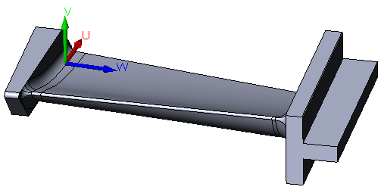
  Split Face: Plane Intersection
Split a group of faces using intersection of the selected faces with the active work plane.
Input:
  Faces to split
  Active work plane
  (Split face)
  (Create curve)
Notes:
Create work plane using work plane from geometry by selecting planar faces at the top and bottom of the blade.
Offset plane 5mm along W towards blade foil. Repeat for the other side.
Use split shortest path to split face in the middle of the foil. Create closed knitted surface.

Slide 10
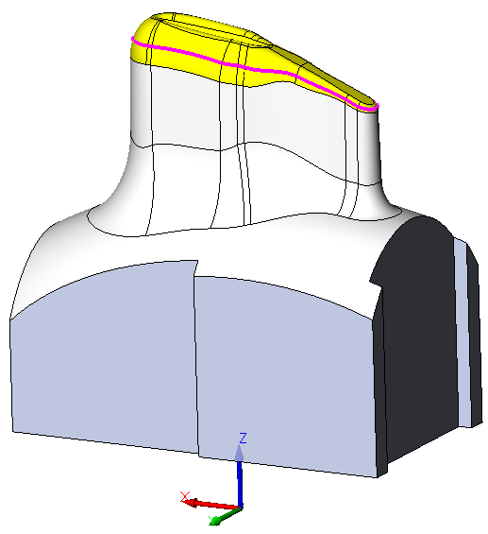
  Split Face: Draft Line
Split a group of faces using draft line
Draft line: profile corresponding to points where slope angle measured in the active work plane is equal to the input draft angle.
Input:
  Faces to split
  Draft Angle
  Active work plane
  (Split face)
  (Create curve)
Notes:
Select yellow faces then split faces with draft line and draft angle = 10 deg

Slide 11
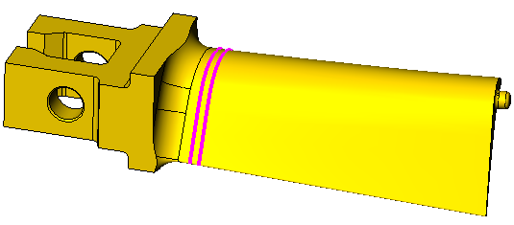
  Split Face: Parametric Curve
Split a group of faces using draft line
Draft line: profile corresponding to points where slope angle measured in the active work plane is equal to the input draft angle.
Input:
  Faces to split
  Parametric Direction
  Parametric Position
  (Split face)
  (Create curve)
Notes:
Split foil face with parametric lines at the bottom of the blade. 2 splits can allow overlap between fillet and foil machining.

Slide 12

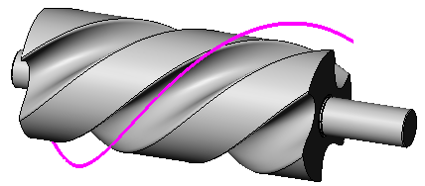
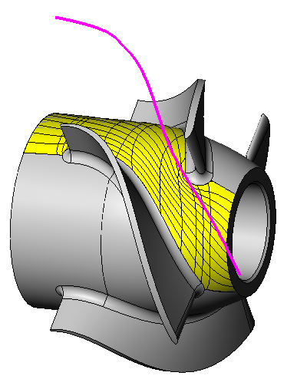
  Curve from Surface
Create curve from a parametric curve of a face or a surface
Curve can be offset from face/surface.
Application:
  Drive curve for 5-axis contouring
  Orientation curve for 5-axis composite
Notes:
1: Select thread face. Create curve along U at 40% with 20mm offset. It creates a good orientation curve for composite cycle.
2: Select knitted surface and create curve along V at 50% with 25mm offset.

Slide 13

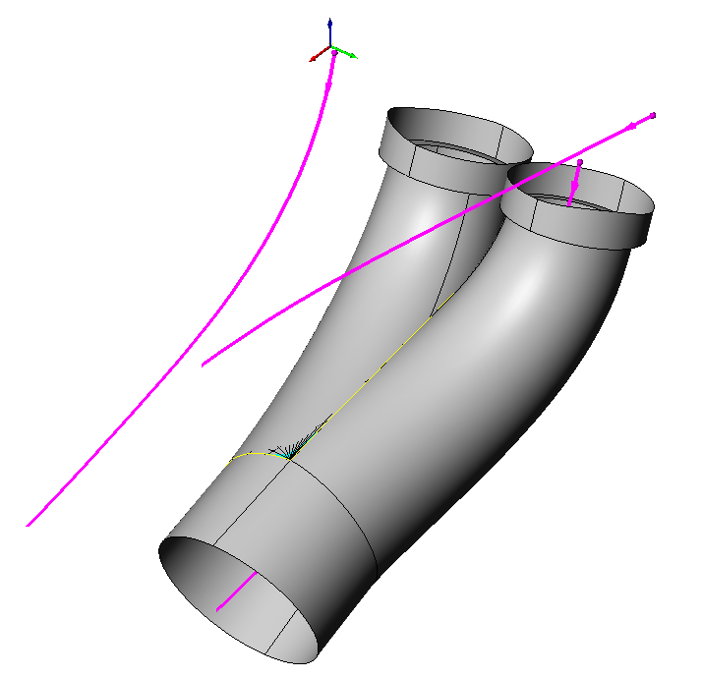
  Projected Curve
Create a feature chain from the projection of 2 profiles onto each other.
Application:
  Spine curve for port machining
  Creation of 3d profile from 2 2d profiles
Input:
  2 Feature chains with work planes not parallel
Notes:
1: Set work plane to ZXY. Switch to wireframe view. Select internal face and create free curves in the middle of the channel.
Repeat with YZX work plane.
Convert both curves to chains then use projected curve to create the spine curve.
2: Show result in second file.

Slide 14
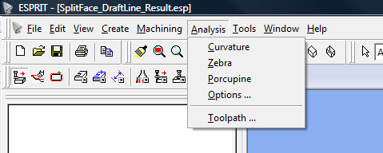
Analysis
Geometry Analysis
  Curvature
  Zebra Stripping
  Porcupine
Tool Path
  Tool path inspection

Slide 15
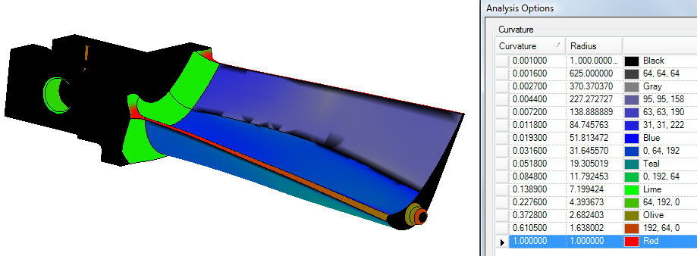
Curvature Display
Menu Analysis / Curvature
Curvature of selected object
Curvature radiuses display on part with color code
Notes:
1 and 2: Show curvature on body and on faces.
Show curvature options.
Show defect on face of second model.

Slide 16
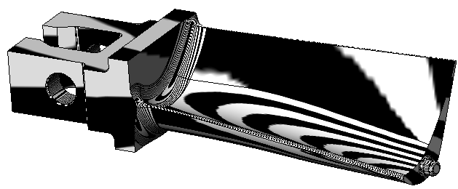
Zebra Stripping
Menu Analysis / Zebra
Zebra of selected object
Zebra: What you’d see on part with mirror finish that is inside a sphere with stripes inside.
Options:
  Zebra color, width and resolution
Notes:
Show zebra on solid body and on faces.

Slide 17



Zebra Stripping
How to use it:
  If stripes discontinuous
  → No tangency
  If stripes continuous but not tangent
  → Tangency
  If stripes continuous and tangent
  → Curvature continuity
Notes:
Show tangency and curvature continuity where faces connect.

Slide 18
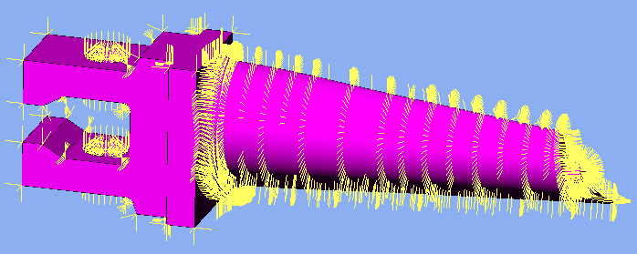
Porcupine
Menu Analysis / Porcupine
Porcupine on selected object
Display surface normal vectors as a grid on a surface
Options: Arrow size

Slide 19
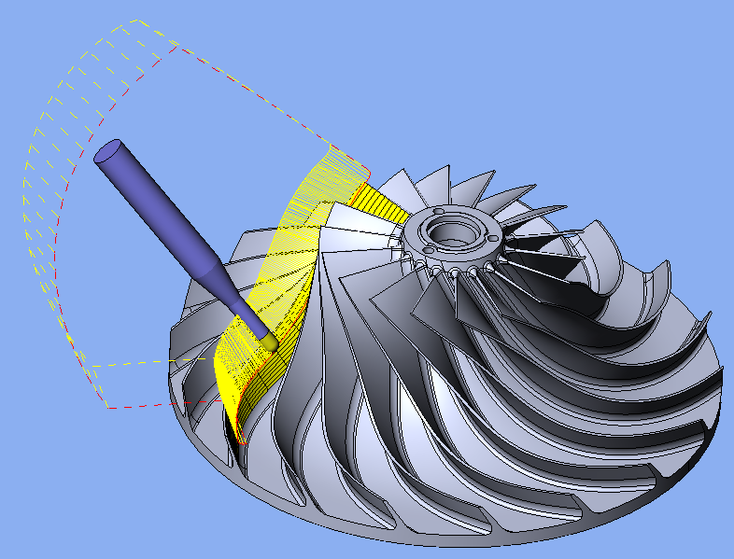
Tool Path Inspection
3-axis and 5-axis tool path only
Display tool on part geometry
Advance tracing of tool positions
Different from simulation, no machine kinematics

Slide 20
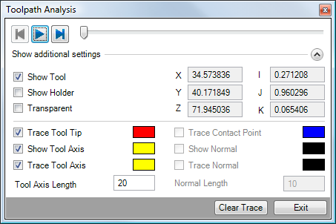
Tool Path Inspection
Control tool position on tool path
FreeForm cycles only
Notes:
Run tool path analysis and show options.

Slide 21
Simulation
5-axis operation and performance of simulation
Backward simulation
Jump to next rapid
Disabling machine solids from collision
Dry-run simulation
Final step

Slide 22
5-axis operation and performance of simulation
E2010: Simulation too slow for complex 5-axis operations
Full realistic simulation can be slow because of:
  Material removal calculation: Complex swept volume
  Rendering: Stock, Target, Machine
  Collision Detection: Full collision everything against everything
Compromise to speed up simulation:
  Material Removal → Increase simulation tolerance
  Rendering → Increase the update frequency
  Collision Detection → Limit collision detection

Slide 23

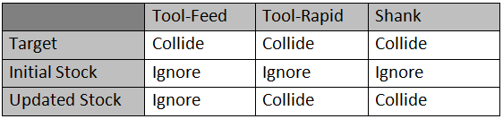
Dry-run simulation
Dry-run simulation = NO MATERIAL REMOVAL
Stock = Final stock if available (stock automation)
else
Stock = Initial stock
Collision detection:
Notes:
Turn on stock automation. Wait for final stock then run simulation with dry-run with collision detection to tool and tool holder.
Turn off stock automation. Add target using part. Show dry run again. Show stock, it doesn’t remove material, it doesn’t collide. Hide stock and show target.

Slide 24
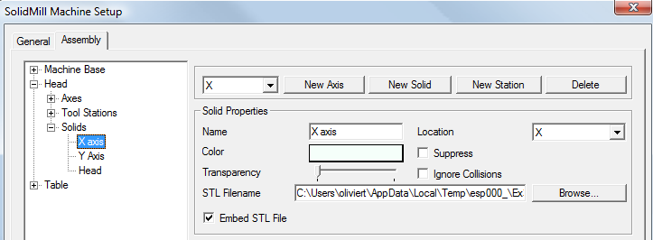
Disabling machine solids from collision
Disabling machine solids from collision
Disable collision detection for solids with no risk of collision.
Notes:
Simulate with collision detection set to full.
Check ignore collision for all machine base solids, all solids before Head.
Simulate.

Slide 25
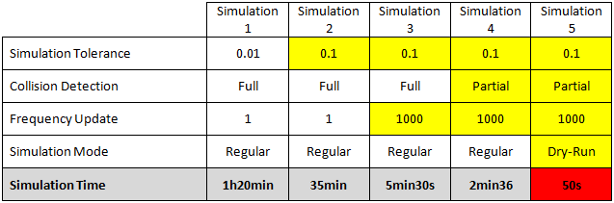
Performance Comparison
Collision detection (machine + Stock) down to 2min36s
Collision detection (machine + “Target”): 50s
Partial collision detection: Solid with no risk of collision excluded from collision detection.
Notes:
File is the file used for matrix.
Set up simulation 4 and 5 and show performance.

Slide 26

Backward simulation
Backward simulation
STEP BACK: Single step back
MULTIPLE STEP BACK: Steps back using multi step mode
Material is not put back (for performance reason)
Step back limited to current operation
Notes:
Show single step back and multiple step back.

Slide 27

Final step
Pause simulation and shows:
  Final stock if nothing has been selected
  Result of last operation of the selection
Require Stock Automation
Creation of stocks:
  Ignore collision
  Skip Rapid movements
RUN FULL SIMULATION FOR COLLISION DETECTION !!!!!
Notes:
Simulate up to first collision.
Then show final step. Final step doesn’t have any collision.
Note: Collision happened because only one face was passed in FFF. Reminder: Pass the whole model in the FFF else there is a RISK of collision.

Slide 28
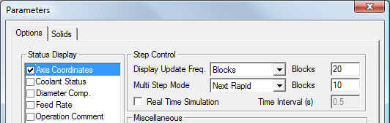
Jump to next rapid
New Multi Step mode: NEXT RAPID
  Play simulation until it reaches a rapid movement.
Convenient to check rapid transitions (links)
Forward/Backward
Notes:
Show to next rapid and back to previous rapid.

Slide 29
3-Axis Operations
General enhancements
  Arcs
  Retract optimization
Parallel Planes Finishing
  Pass extension
Z-Level Finishing
  Pass extension
Between Curves Finishing
  Input type
  Pass Extension

Slide 30
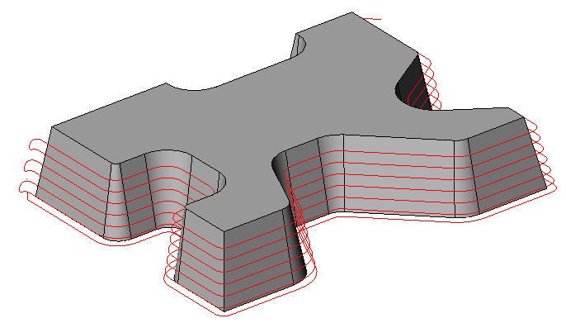
Arc Output
G02 / G03 to NC Code
  Always output
  Optimize tool path only for ESPRIT FreeForm operations
  No change required to the post
  Helical entry made of segments
Notes:
Enable sub element selection.
Select element for round corner in tool path. Element is a segment.
Rebuild operation then select same element. Element is an arc.

Slide 31
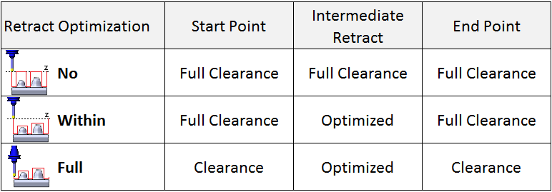
Retract Optimization
No / Within / Full
Full clearance is ignored if below start/final tool position
Notes:
Retract optimization = Full all 3 ops. Simulate last 3 operations and show collision during transition.
Edit retract optimization and change it to no and set full clearance to 10mm for all 3 operations. Simulate last 3 operations. It doesn’t collide anymore.
Edit retract for first operation and change it to within. Retract between passes is now optimized.

Slide 32
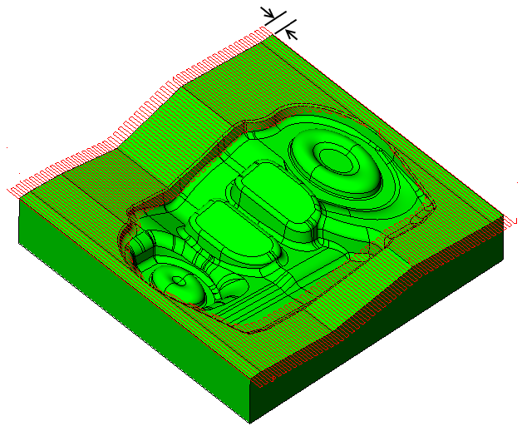
Parallel Planes Finishing
Tangent Pass Extension
Tangent extension at start and
end of all passes
Notes:
1: Edit operation and set tangent pass extension to 5mm.
2: Show tangent pass extension

Slide 33
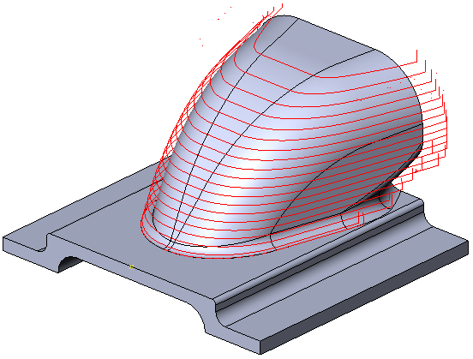
Z-Level Finishing
Tangent Pass Extension
Tangent extension at start and
end of all passes
Notes:
Edit operation and set tangent pass extension to 8mm.

Slide 34






Between Curves Finishing
Input Types:
  2 Profiles
  Ruled Feature
  Open Surfaces: Require input of start/end check surfaces
  Looping Surfaces
Notes:
1: Create FFF with variable fillet on top as part, body as check. Create operation with 10mm ballmill. Select start end surface.
Show position on check surface.
2: Start end surface not valid on one side. Use split face to create extremity face then create operation with 8mm ballmill.
3: Create operation with 8mm ballmill to cut fillet.
4: Create operation to cut yellow faces with 8mm ball mill.

Slide 35
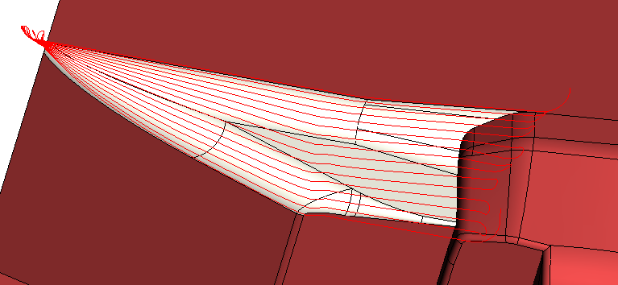
Between Curves Finishing
Tangent Pass Extension
Tangent extension at start and
end of all passes
Notes:
Show tangent pass extension.
Edit operation and change the start point (digitize vertex on one of the highest edges)

Slide 36
5-Axis Operations
General enhancements
  Point distribution
  Retract Optimization
Surface Swarf
  Incremental depth
  Tapered Tool
Contouring
  Lateral passes and incremental depth
  Tool Orientation

Slide 37
5-Axis Operations
Composite
  New Passes options
  Normal to model or drive
  Autotilt
Impeller
  FreeForm feature
  Pass Extension
  Tapered Tool
Links
  New approaches
  Rapid links

Slide 38
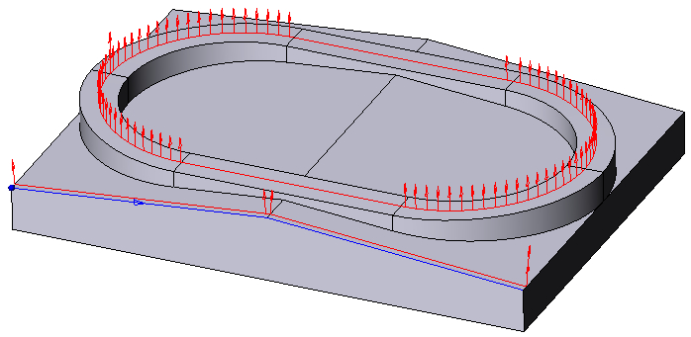
5-Axis Point Distribution
Point Distribution
  Limit Distance between points
  MaxPrimaryAngleIncrement, MaxSecondaryAngleIncrement:
  Post variables, limit angle increment between 2 instructions.
Notes:
With operation 1, show mask Tool Point-Axis.
Edit operation and turn on limit distance between points. Set distance to 1mm.
With operation 2, simulate and notice roll over of C-axis at the middle of the pass.
Post out long NC code using “5-Axis_Post.asc”. Then post out long NC code using “5-Axis_MaxAngleIncrement.asc”.
Compare the 2 long codes and notice the added points every degree with second post.
These points are important if not using RTCP.

Slide 39
5-Axis Retract Optimization
Retract Optimization
  Same as for 3-axis operations
  Within Operation: Useful for internal machining
  Warning: Risk of collision if lollipop tool undercutting on last point
Notes:
Notice the retract height at the end of the machining.
(E2010 required programming of a manual operation for retracting the tool).

Slide 40
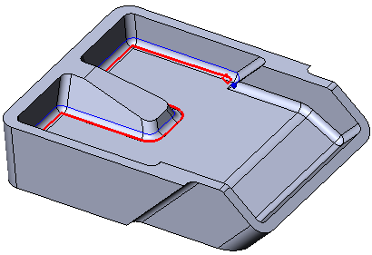
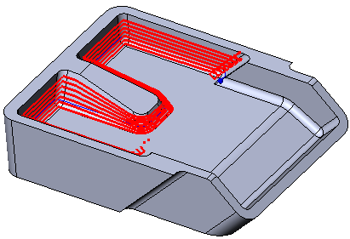
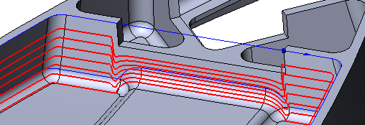
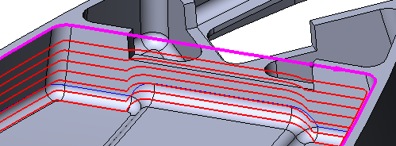
Surface Swarf: Incremental Depth
Single pass full depth or incremental passes along wall
Upper profile is optional
Notes:
1: Create chain from edges. Notice new selection order. Create surface swarf cycle with 3mm ballmill.
Input only lower profile and set inceremental depth to 2mm.
2: Create surface swarf operation with 4mm ballmill and 2mm incremental depth. First input only lower profile then input upper profile. See differences with pass geometry.

Slide 41
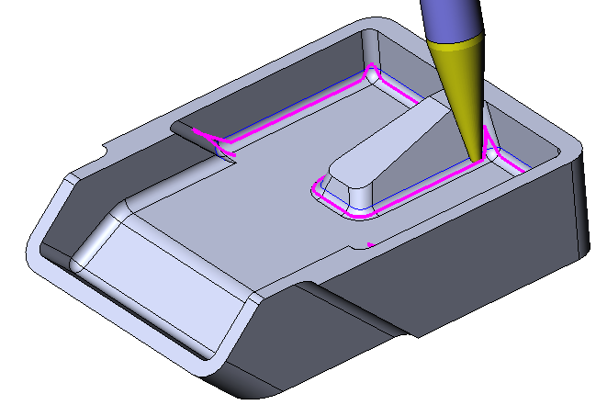
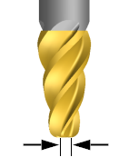
Surface Swarf: Tapered Tool
Tapered Tool:
  Spherical tool end:
  Taper End Mill with Tip Diameter equal to 0
0
Notes:
Edit operation and change tool to tapermill D1mm.

Slide 42
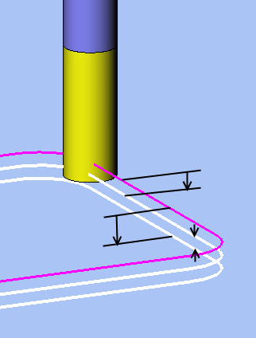
Contouring: Passes Definition
Depth Passes
  Start Delta Z
  Incremental Depth
  End Delta Z
  Start/End Delta Z sign:
  Positive → above drive
  Negative → below drive (penetration)
Start Delta Z
End Delta Z
Incremental
Depth
Notes:
Create operation with 2mm endmill.
Start delta Z = -0.5
Incr. depth = .5
End delta Z = -1

Slide 43
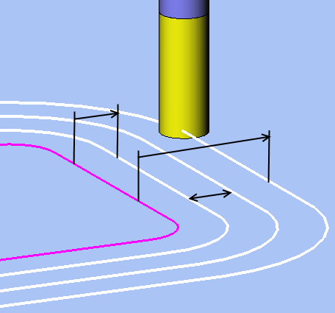
Contouring: Passes Definition
Lateral Passes
  Drive Profile Offset: Offset final pass
  Maximum Lateral Offset: Offset first pass
  Lateral Pass Increment: Increment between 2 passes
Drive Profile Offset
Maximum Lateral Offset
Lateral Pass Increment
Notes:
Edit operation and set:
Drive profile offset: 1mm
Maximum Lateral offset: 3mm
Lateral pass increment: 1mm

Slide 44
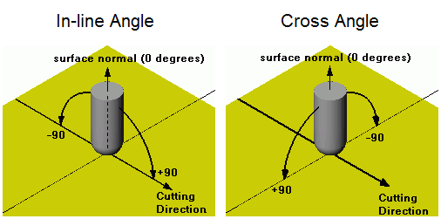





Contouring: Tool Orientation
In-Line Cross Angles
Angle Limitation
Prevent Cut with Tool Center
  Only if Limitation=Fixed angle with
Notes:
Edit operation and set cross angle to -30 deg. Simulate.
Edit operation and fix orientation with X-axis to 70deg. Simulate.
Edit operation and enable prevent cut with tool center and set tool center to 80%.

Slide 45
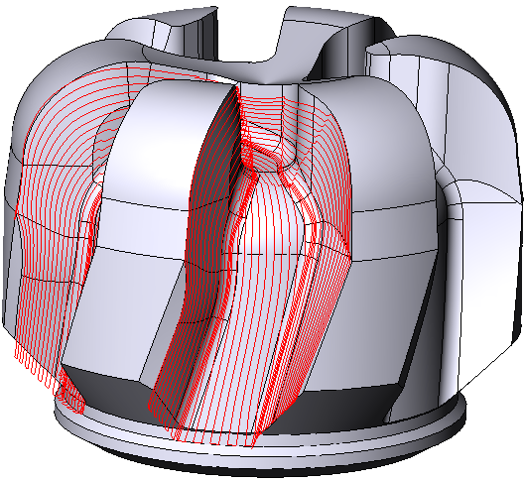
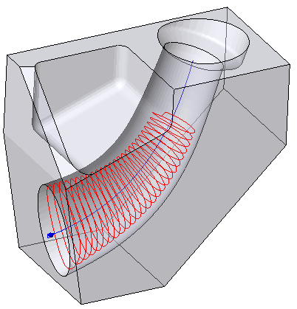
Composite: Passes Definition
Tangent Pass Extension
  Finish and Rough passes
Remove Final Incomplete Passes
  Stop passes on first interruption
Notes:
1: Edit operation and set tangent pass extension to 5mm.
2: Edit operation and turn on remove incomplete passes.

Slide 46


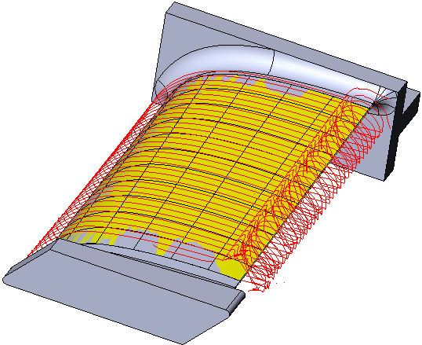
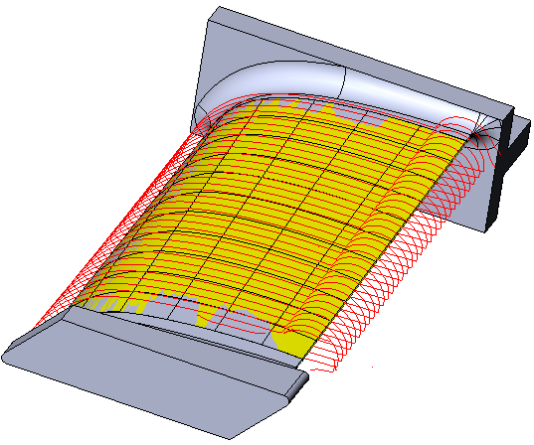
Composite: Tool Orientation
Normal to model
  Available with all patterns
Normal to Drive (2010 behavior)
  Available with all pattern with a Drive Surface
When cutting using knitted surface as drive, use Normal to Model for better stability.
Notes:
Edit operation and change the orientation strategy to normal to model. Tool path is now smooth on the blade edges.

Slide 47
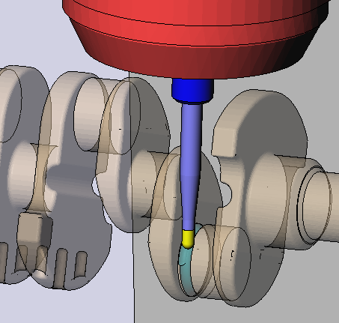
Composite: Tool Orientation
Prevent Cut with Tool Center
  Only if Limitation=Fixed angle with
Forces the system to move contact point outside a minimum diameter.
← Y-axis shift so tool contact point with part is not inside a diameter equal to 75% the tool diameter.
Notes:
Create spiral machining with composite using drive surface in hidden layer.
Tool: 12mm ball mill
Step increment: 2mm
Orientation normal to drive
Fix angle with X-axis to 90 deg. Enable autotilt with 1mm shank clearance. Simulate.
Enable prevent tool center cut with tool center % diameter = 75%. Simulate.

Slide 48

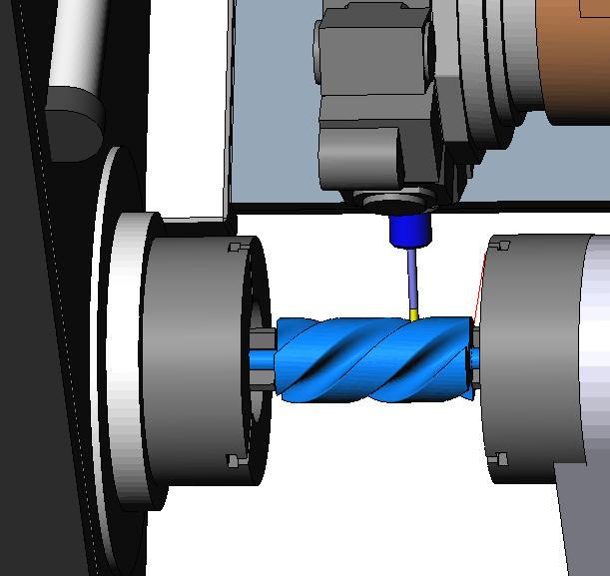

Composite: Tool Orientation
Orientation from Curve
  Toward Profile
  NO
  YES
  Allow orientation curve below
  the tool.
Notes:
Orientation curve on center line.
Simulate. Y=0
Only a few passes created with WC build.

Slide 49
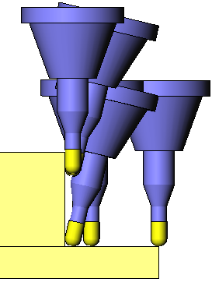
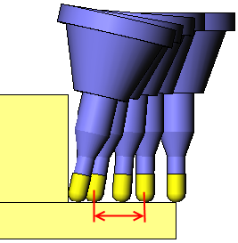
Composite Autotilt
Enable Smoothing:
  Smooth out the rotation of the tool along a pass
  Smoothing distance: Distance to distribute the rotation.
  Smoothing distance = 0 → Maximum distribution along the pass
No Smoothing
Smoothing
Smoothing Distance
Notes:
Simulate.
Edit operation, turn on smoothing and set smoothing distance to 10mm. Simulate.
Edit operation and set smoothing distance to 0. Simulate.

Slide 50
Composite Autotilt
Reminder:
  Tool tilts if SHANK starts colliding.
  Cutter collision because of bad orientation strategy won’t force tool rotation.
Notes:
Edit second operation and turn on autotilt. It won’t tilt the tool because collision on the wall is with cutter.
Edit operation and change tool to BM_HM04 CL6 (cutting length 6mm instead of 20mm). Set smoothing to off. Simulate.
Edit operation and turn on smoothing with 0 smoothing distance. Simulate.

Slide 51
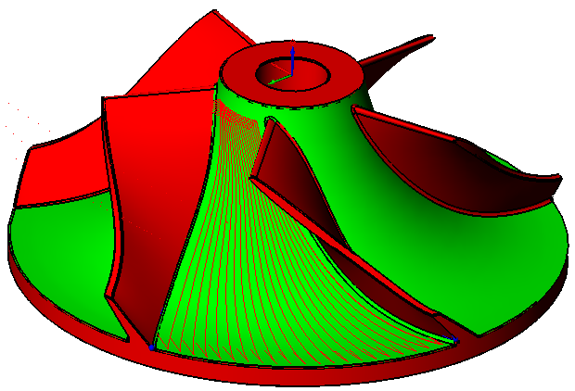
Impeller: FreeForm Feature
FFF creation:
PART: Hub + Fillet connecting hub to blade (floor)
CHECK: Everything else
DON’T set blade
surfaces as part else passes may
climb on blades !!
Notes:
Create 2 FFF for impeller without splitter blade then for impeller with splitter blade.

Slide 52
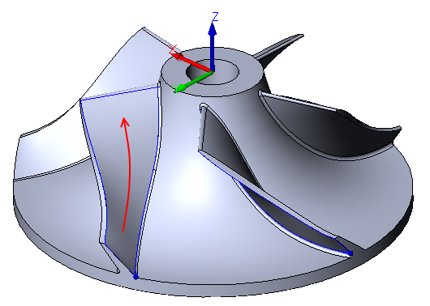
Impeller: Ruled Features
Reminder:
Make sure to respect top/bottom profile orientation
Ruled feature should have SAME orientation
Orientation MUST follow the direction of the impeller axis:
  If Axis = Z-axis, starts from lowest Z side to highest Z side
Upper profile
Lower profile
Notes:
Create 8 chains then create the 4 ruled features with meaningful names.
Note: Selection priority has changed.
Note2: Cutting side doesn’t matter for impeller cycle; cycle cuts between left and right features.
Note3: Matchlines of ruled features are not used with impeller cycle

Slide 53
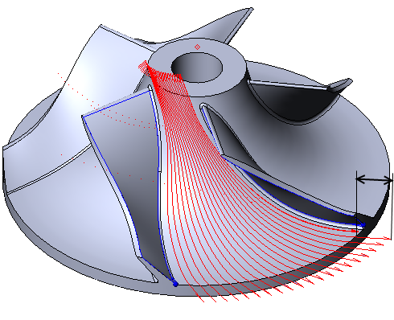
Impeller: Passes Definition
Tangent Pass Extension:
  Extension IN and OUT
  Rough and finish passes
  Rough passes: Risk of collision if tool doesn’t start outside of material after extension.
Notes:
Create Impeller cycle for impeller with no splitter .
Start with: Tool BM_HM12; RTCP yes; Tolerance:0.05; Stock allowance:0.5; Roughing with 6mm incr. depth and 8mm step over. No extension.
Edit operation and set tangent extension IN to 10 and tangent extension out to 10.
Notice extension doesn’t occur on deepest passes because it would create a collision.
Suppress first operation. Because of stock automation, stock must be the initial stock so no first roughing.
Create operation for impeller with splitter with these parameters:
Tool BM_HM08; RTCP yes; Tolerance:0.05; Stock allowance:0.5; Roughing with 5mm incr. depth and 5mm step over. Extension IN and OUT 6mm.
For impeller with splitter balde, create finish operation with:
Tool BM_HM10; RTCP yes; Tolerance:0.05; Stock allowance:00; Finishing and 3mm step over. Extension IN and OUT 6mm.
Notice that extension works for finish pass.

Slide 54
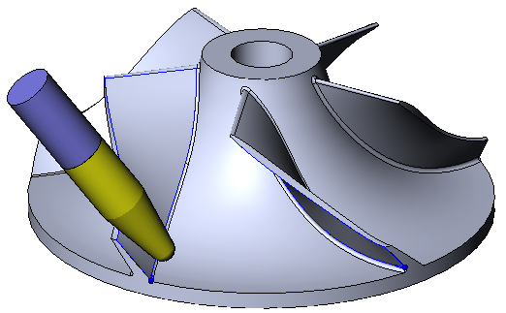
Impeller: Tapered Tool
Tapered Tool:
  Rough and Finish
  Spherical tool end:
  Taper End Mill with Tip Diameter equal to 0
0
Notes:
Edit tool Tapermill. Verify tip diameter is 0.
Edit roughing operation and change tool to tapermill. Simulate.
Edit finishing operation and change tool to tapermill. Simulate.

Slide 55
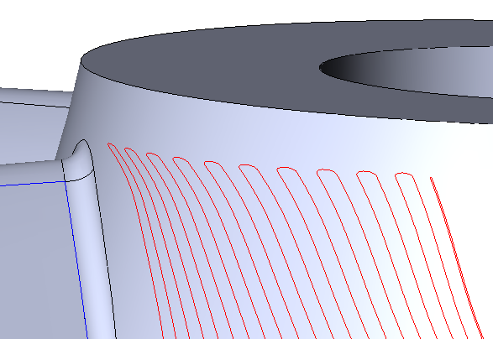
Impeller: Links
New Feed Links and approaches for impeller FINISHING
  Approaches:
    Vertical, Radius, Radius in vertical plane, Radius in lateral plane
  Feed Links:
    Adaptive, Smooth, Bridge
Notes:
Edit hub finishing operation and change pass movement to zigzag.
Edit feed links and add 1-Adaptive 2-Smooth 3-Bridge with defaults parameters.
Rebuild and simulate.

Slide 56


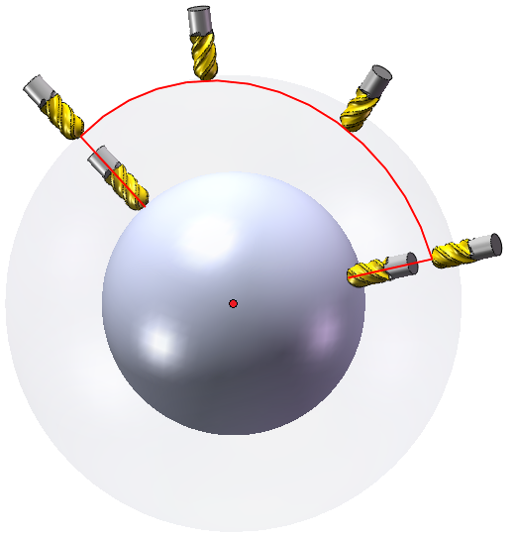
Links
New approaches
  Radius in Lateral Plane
  Radius in Vertical Plane
Rapid links
  Radial Out of Sphere

Slide 58
THANK YOU !!
Questions ? Comments ?

Slide 59
Notes:
Hexapod simulation within ESPRIT.
Machine any Part Geometry - ESPRIT’s seamless CAD to CAM interface directly imports any native part model from any source, fully intact, with no need for programmers to edit or rebuild geometry. ESPRIT directly machines from any combination of geometries — solids, surfaces, wireframe, or STL — providing you with complete manufacturing flexibility. Starting with 100% complete and accurate part geometry eliminates nearly all of the difficulty in programming complicated parts and dramatically reduces programming time .
Universal Post Processing - ESPRIT’s universal post processor effortlessly creates the high-quality G-code you need to fully exploit your machine tool investment. With ESPRIT you get proven out-of-the-box operation with a complete library of pre-defined post processors. Additional factory-certified posts are available for many of the leading machine tool brands, and ESPRIT’s open architecture allows you to easily adjust any post processor to suit your personal preferences and shopfloor requirements. ESPRIT’s flawless G-code means you will spend more time cutting parts, giving you maximum machine utilization and optimal part quality at the lowest possible cost.
Dynamic Solid Simulation and Verification - ESPRIT’s fast, accurate, and reliable dynamic solid verification eliminates the need for expensive dry runs on the NC machine. Gain complete confidence in your machining process as you compare accurately rendered “as designed” versus “as machined” parts. High-performance, real-time simulation and comprehensive collision detection ensure that even the most complex of parts will be machined correctly the first time. ESPRIT gives you exhaustive verification of the part program simulated within a complete machining environment: machine tool, fixtures, clamps, stock, and workpiece. Minimize downtime, maximize manufacturing efficiency, and cut machining costs while gaining complete confidence in your machining processes with ESPRIT.
- An example of what is possible…Programming any machine tool
- 6 axis milling (a hexapod)
- Fully simulated in dynamic 3D Solids

